Slide 1
Self-Control
Food App.

Slide 2
DESIGN IDEA
People use apps to solve a problem - let's develop an app for people to control the way they eat food.
Users take picture of food and answer questions about the food they are trying to resist. Users swipe on a subset of foods every time they open the app.
App contains four parts - take a picture, food gallery containing pictures, monthly review of foods, Tinder like swiping feature to practice resisting foods.

Slide 3
DESIGN GOALS
Phase 1 - Building a food library.
Phase 2 - Weekly reviews of foods (first iteration contained daily reviews, which have since been removed).

Slide 4
TECH STACK
Android app dev - Visual Studio (C#)
Pictures database - SQLite
Questions/ Responses database - Excel
Mockups - Invision, Sketch

Slide 5
LAYOUT AND NAVIGATION WIREFRAMES

Slide 6
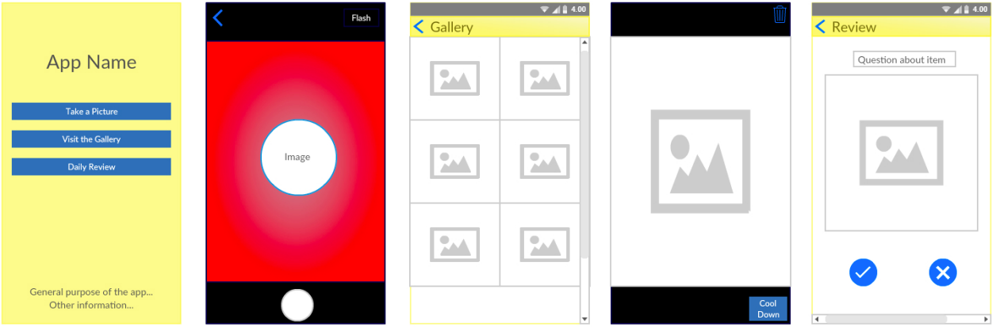
Iteration 1
Main page - Containing all activities of the app.
Camera page - Designed with a small circumference to focus on food.
Gallery page - Tile format with two images per row.
Swiping page - Tinder swiping format with cool down/ heat up buttons.
Swiping page - Tinder swiping format with cool down/ heat up buttons.

Slide 7
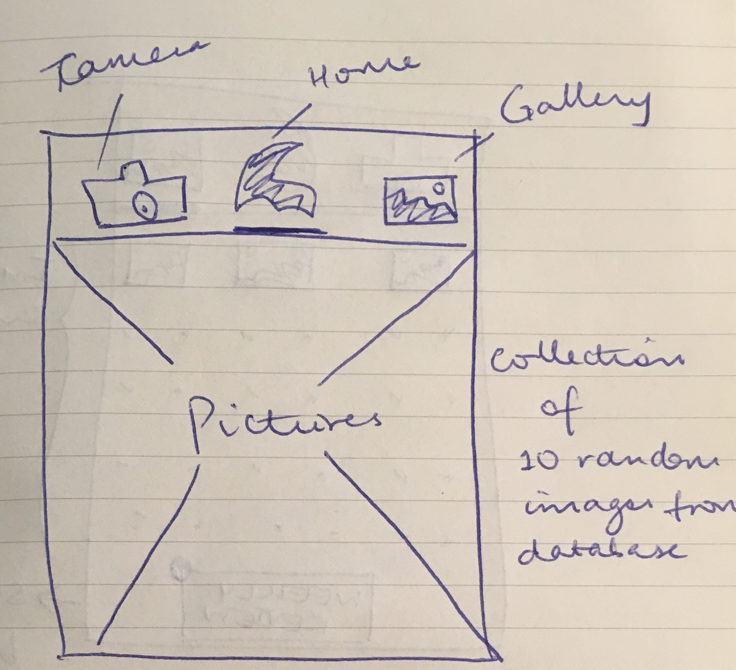
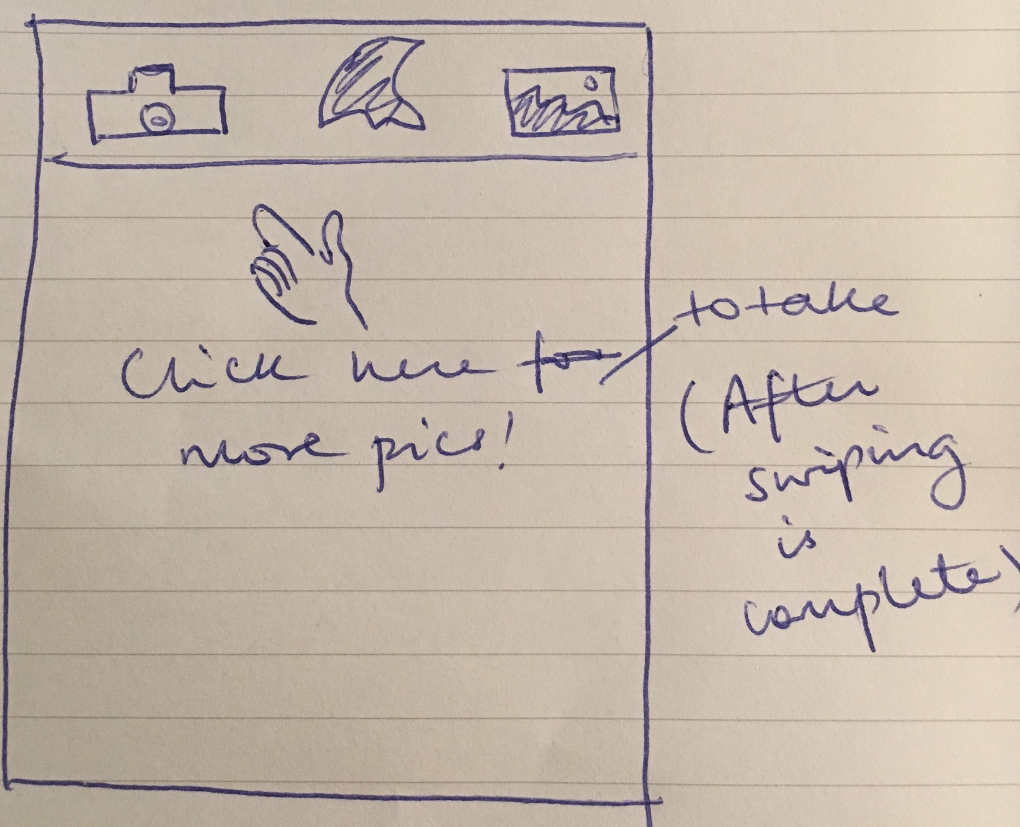
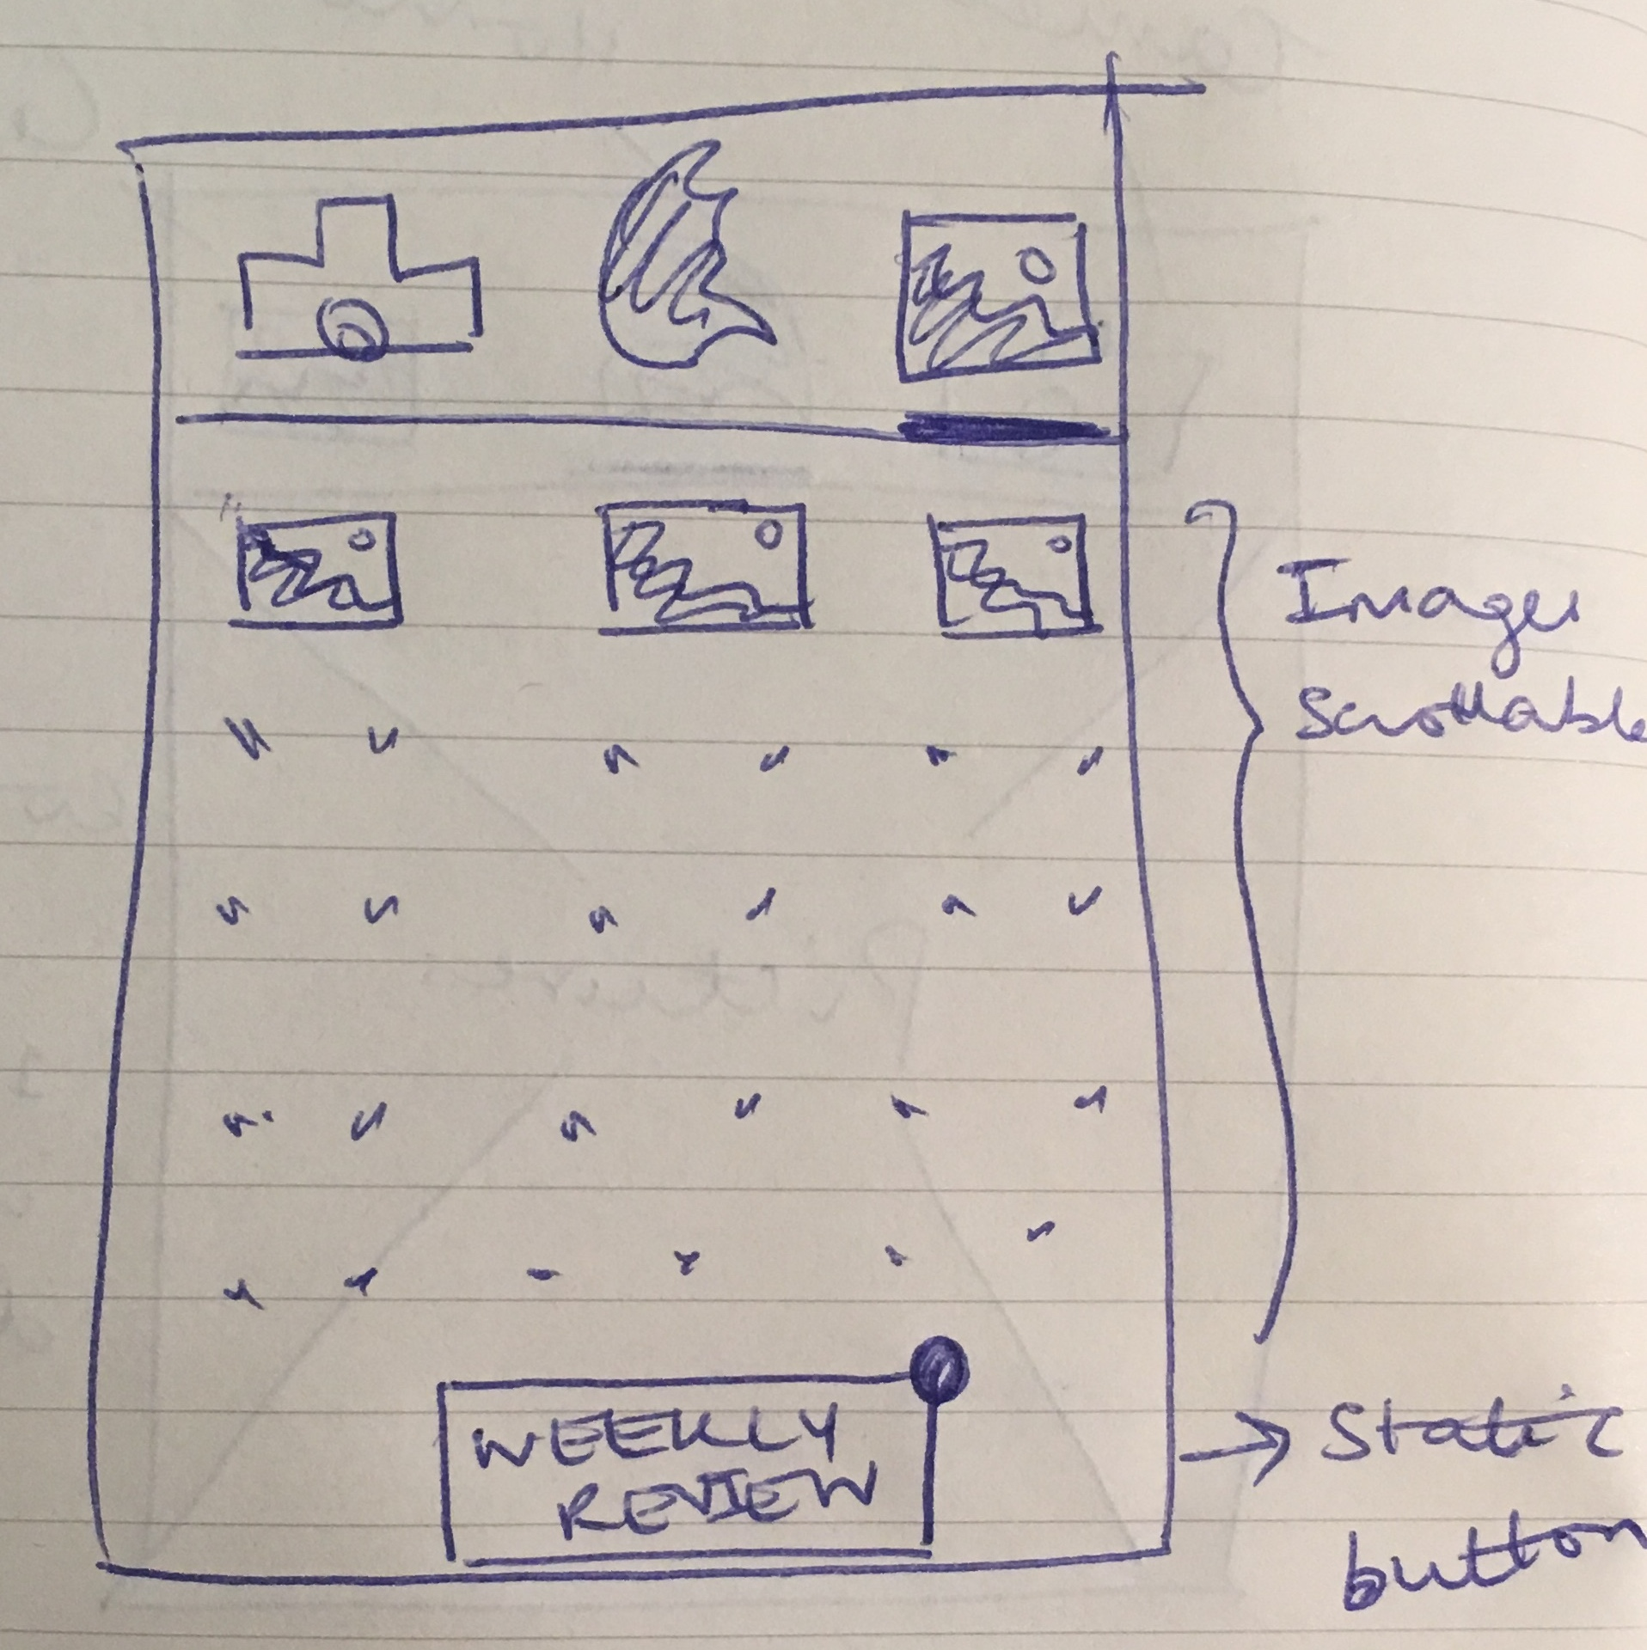
Iteration 2
Main page - App opens directly to swiping pictures (10 random images). Main purpose of the app is accessed immediately. Remove buttons from main page to make app more intuitive.
Main page - Once user swipes all 10 pictures, app displays text notifying the user to take more pictures. Text provides more context to users and guides them to next step.
Gallery page - Displays images in tile format, split by 3 images per row. Weekly review button is static on page. Button contains red signal which notifies user to complete weekly review at the end of the week.

Slide 8
PHASE 1 -
BUILD FOOD LIBRARY
Practice swiping on foods which a person to practice in a more “controlled” situation on the foods/drinks that they frequently feel a desire and tempted to eat/drink more of.
Take pictures of foods they would be eating/drinking during the week (i.e - the foods they are also looking to resist)

Slide 9
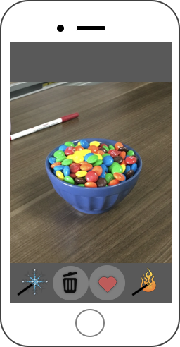
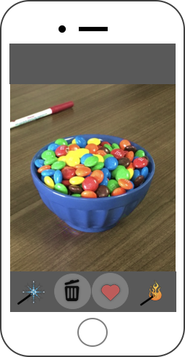


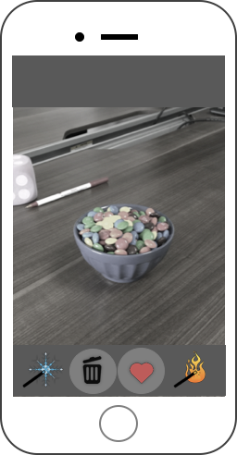

Practice swiping - (Cooling/ making hot)
Makes food appear brighter, making food appear more enticing
Makes food appear distant, making food appear less enticing

Slide 10
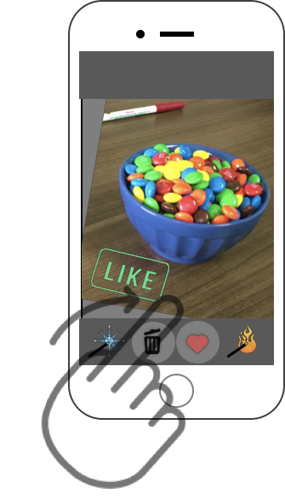
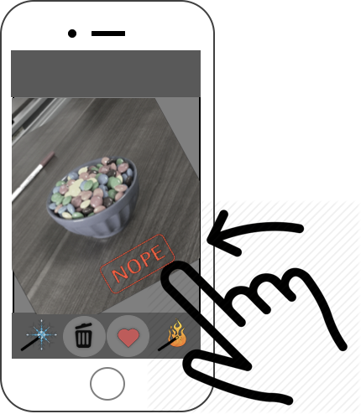
Practice swiping - (Swipe left/right)
User can also use a swiping gesture similar to Tinder.
Swipe left = Avoid food
Swipe right = Eat more!

Slide 11
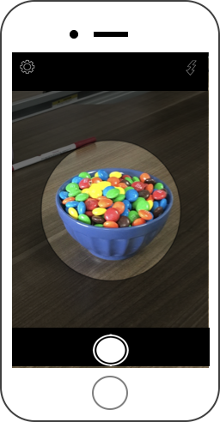
2. Take a picture
After taking a picture, a person will answer multiple questions including:
How much do you like this food/drink?
How tempting this food/drink is to you?
How healthy you think this food/drink is?
How frequently do you eat/drink it?
How frequently do you want to eat/drink it?

Slide 12
PHASE 2 -
WEEKLY REVIEWS
The weekly review questions resembles the questions each person answers in phase 1 (Building a library activity) about each specific food/drink.
We want to see if there were any changes in the attitude and experience of desire toward a food/drink, the frequency of eating a food (as one measure of self-regulation success).

Slide 13
DEMO
(ANDROID PROTOTYPE)

Slide 14
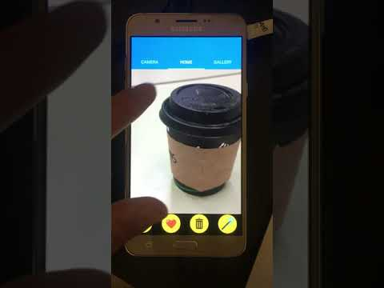

Slide 15
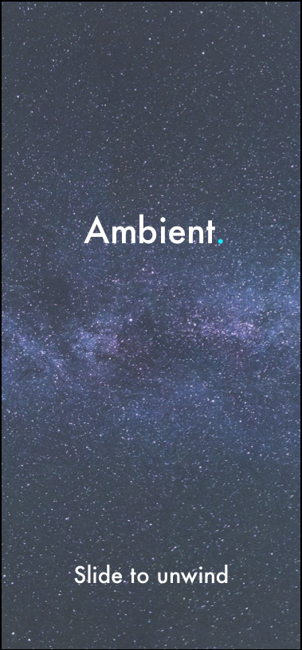
Ambient.
Art Therapy App

Slide 16
DESIGN IDEA
App that provides art therapy aims to ALL people regardless of age, gender, race
Art will be in the form of music playlists, books, art posters.

Slide 17
DESIGN GOALS
Introduce users to new forms of art through a simple, easy-to-use interface
Enable users to track their mood over a period of time
Match users with each other based on mood/art recommendation
Foster inspiration and creativity in users.

Slide 18
TECH STACK
iOS app dev - React
Mockups - Invision

Slide 19
GATHERING USER REQUIREMENTS
Method #1 - Interviews
Method #2 - Use cases

Slide 20
METHOD #1 INTERVIEWS
Goal
Understand the users and their familiarity their technology
Identify features based on their needs
Establish mental models through questions
Strategy
Interview five people from diverse backgrounds (age, gender, profession)
Results
Participants have all interacted with mobile apps
Most users found the idea of art therapy novel
All users have interacted with some form of art

Slide 21
METHOD #1
SUMMARY (USER NEEDS)
Easy and intuitive way to input mood
Write notes about their current mood
Short amount of time to input their mood
Reminders to input mood or get art therapy
The ability to save certain art to the app
Visual representation of inputted mood

Slide 22
METHOD #2
USE CASES
Goal
Gather user requirements based on type of user
Strategy
Define use cases based on type of user and usage of app to define functional requirements
Results
Provided insights on must have functional requirements in design
Three types of navigations considered - Initial course, alternative course A, alternative course B

Slide 23
METHOD #2
SUMMARY (REQUIREMENTS)
Register and onboard
Users can register and receive a confirmation when successfully registered
Track mood
Users can input their mood and visually track their mood over time
Discover art
Different forms of art will be provided to the user based on their inputted mood
Connect users
Users will be matched with other users based on recommended art

Slide 24
LAYOUT AND NAVIGATION WIREFRAMES

Slide 25
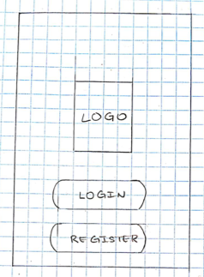
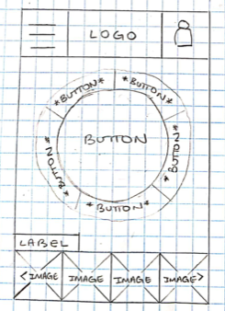
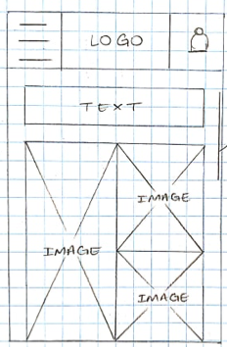
Onboarding Page
Application of “Rule of Thirds” with branding on top 2/3 of screen and registration buttons on 1/3 of screen
Considered pill shape for button sizes
Mood Input Page
Header: Hamburger menu for navigation, app logo and user profile
Workspace: Buttons to input mood in centre of page to afford clickability.
Footer: Provide visual view of user moods over time by using emojis
Art Recommendation Page
Header: Hamburger menu for navigation, app logo and user profile
Workspace: Text label to reiterate current view of app
User can view recommended art moodboards in grid layout by scrolling

Slide 26
MOCKUPS

Slide 27
App title
“Rule of thirds”
Provides main focus for page
Native slide control for footer text
Text margin affords slide control
Slide control moves left, providing recall for iOS platforms
Font: Futura
Provides “modern” feel
Galactic background
Provides an immersive experience for the user
Home

Slide 28
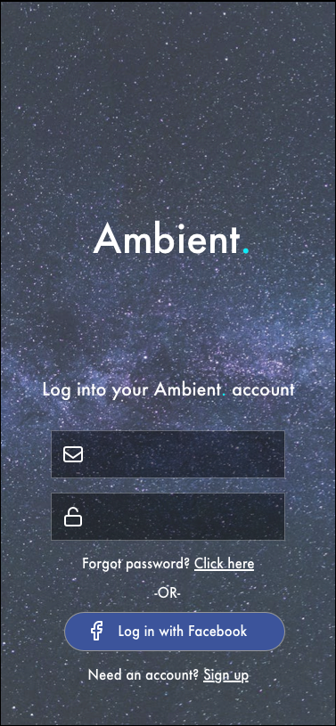
Consistent application of “Rule of thirds”
Consistent colors and font
Use of icons to afford recognition of login fields
Remove redundant text
Input fields sized based on iOS design guidelines
User can log into app with Facebook credentials
Follow modern app design guidelines
Onboarding

Slide 29
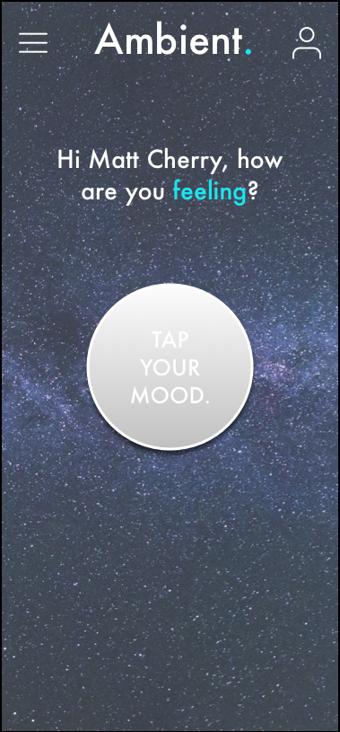
Header
Contains hamburger menu, app title and user icon
Minimalist design considered to eliminate information overload
Body
Contains button, big enough to afford clicking for user
Shadow effect on the button to make it intuitive for tapping
Consideration of text to provide a more inviting and warm user experience
Mood Input

Slide 30
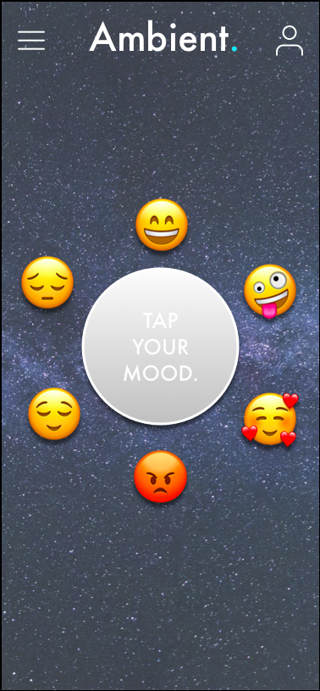
Header
Consistent design
Body
Emojis reflecting moods (preset), fly out from once the user taps the button
Emoji size considered to afford clicking
User taps on an emoji (based on user’s mood)
Choose mood

Slide 31
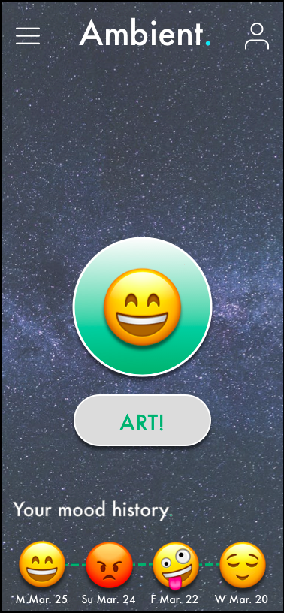
Header
Consistent design
Body
Accent colour of the application changes to reflect mood selected by user
‘Art’ button displayed to provide art recommendations to user
Footer
Mood history displayed for last four days to allow user to track mood variations over time (system feedback)
Mood selection

Slide 32
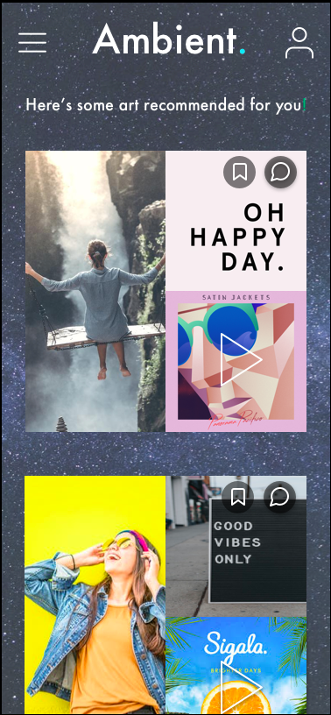
Header
Consistent design
Body
Scrollable view containing artboards
Each artboard consists of three different forms of art (i.e - Poster, quote, song)
Artboard cutoff on the bottom off the screen, to recall scrolling
Use of icons to ‘bookmark’ and ‘join conversation’ on artboards
Art curation

Slide 33
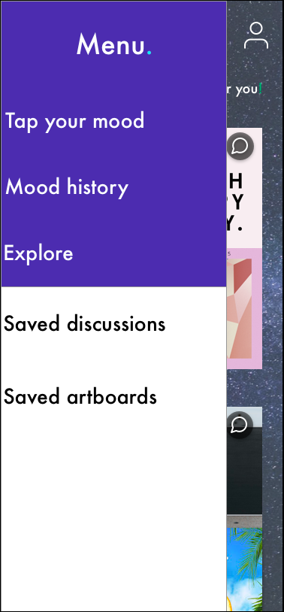
Collapsible menu saves screen space
Accessible from all pages
Intuitive swipe controls to close menu
Hamburger menu

Slide 34
USER TESTING
OVERVIEW
Defined usability methods, goals and scripts for user tests
Applied cognitive walkthrough and heuristic evaluation tests
Completed user testing with five users, including young adults (20-23) and mature adults (45-50)
User testing completed with high-fidelity mockups on Sketch
Recorded data on user feedback during testing
Summarized results and iterated app design using feedback

Slide 35
USER TESTING
GOALS
Ease of learning
≥ 80% of users must easily and accurately identify the emoji reflecting their mood
≥ 80% of users must easily describe their historical mood variation
Efficiency of use
≥ 80% of users must be able to navigate to certain pages in the app without vocal instruction ≥ 1 minute
≥ 80% of users must encounter less than two errors per task
User satisfaction
Users must score ≥ 6 on a 7-point likert scale for satisfaction
Users must score ≥ 6 on a 7-point likert scale for confidence
Discoverability
Users must score ≥ 3 on a five-point likert scale for satisfaction
Users must score ≥ 3 on a five-point likert scale for confidence

Slide 36
USER TESTING
METHODOLOGIES
Method #1 - Cognitive Walkthrough
Method #2 - Heuristic Evaluation

Slide 37
METHOD #1
COGNITIVE WALKTHROUGHS
User tries stepping through interface pretending the interface is fully built, with help from facilitator
Aim to find major problems within design based on areas of confusion or circuitous paths

Slide 38
METHOD #2
HEURISTIC EVALUATION
Inspection done by several experts in usability, each evaluating against a set of usability principles to uncover problems in design

Slide 39
USER TESTING
TASK SCENARIOS
Task #1 - Log in using Facebook credentials
Task #2 - Choose a mood (happy) and describe historical mood variation given system feedback
Task #3 - Choose a mood (sad) and bookmark a recommended artboard of your choice
Task #4 - Join a conversation for a recommended artboard of your choice
Task #5 - Log out of the application

Slide 40
USER TESTING
PERFORMANCE MEASURES
Speed
Users must take ≤ 1 minute to complete a task
Accuracy
Users must make ≤ 3 errors per task on average
Experience
Users must have a rating of ≥ 6 regarding their experience with the app (7 point scale)
Feedback
Users feedback must contain positive sentiment regarding the system feedback (i.e - recommended artboards, discussions etc)

Slide 41
USER TESTING
RESULTS
Low error rate (1 error/per task/per user on average)
Users take approximately 1.7 minutes to complete a task (on average)
High satisfaction rate (satisfaction rating of 6 on average)
High confidence rate( confidence rating of 7 on average)

Slide 42
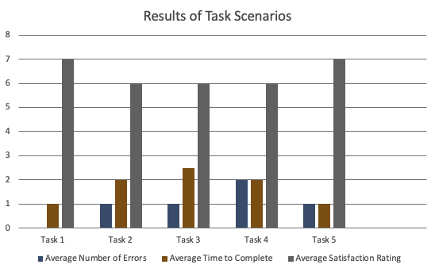

Slide 43
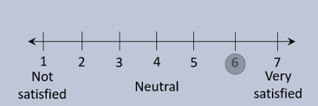
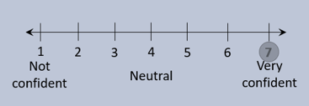
How satisfied are you to accurately input your mood and receive suggested art?
(Average rating - 6)
How confident are you to accurately input your mood and receive suggested art?
(Average rating - 7)

Slide 44
“It would be really nice if the app can show art events taking place around the area!”
“The app is very easy and fun to use”
“I wish there were more icons to represent the moods”
“I find the icons that represent the mood to be fun. It’s a good way to capture how I’m feeling”

